Slide 1


Course: Data Structure​
(Course Code: ETCCDS202 )​
​
UNIT-1: Foundations of Data Structures​
Dr. Shahjad, Mr. Deepak, Ms. Neetu
School of Engineering & Technology
K.R. Mangalam University
Notes:
New Courses replaced with New Programmes

Slide 2

Unit-1: Foundations & Algorithmic Analysis
Session 1 | Introduction to Data Structures
Session 2 | Abstract Data Types (ADTs)
Session 3 | Time & Space Complexity (Big-O, Θ, Ω)
Session 4 | Best, Average & Worst Case Analysis
Session 5 | Common Time Complexities
Session 6 | Divide & Conquer Paradigm
Session 7 | Greedy & Dynamic Programming
Session 8 | Recursion: Concept & Call Stack
Session 9 | Recursion: Base Case & Examples
Session 10 | Revision (Unit–1)
Notes:
New Courses replaced with New Programmes

Slide 3
Unit 2: Linear Data Structures
Session 11 | Arrays – 1D & 2D
Session 12 | Static & Dynamic Arrays
Session 13 | Linked Lists Types
Session 14 | Linked List Operations
Session 15 | Stack ADT & Operations
Session 16 | Stack Applications
Session 17 | Queue ADT
Session 18 | Queue Applications
Session 19 | BFS using Queue
Session 20 | Revision (Unit–2)
Notes:
New Courses replaced with New Programmes

Slide 4
Unit 3: Sorting Algorithms
Session 21 | Introduction to Sorting
Session 22 | Bubble Sort
Session 23 | Selection Sort
Session 24 | Insertion Sort
Session 25 | Merge Sort
Session 26 | Quick Sort
Session 27 | Heap Sort
Session 28 | Counting Sort
Session 29 | Radix Sort
Session 30 | Revision (Unit–3)
Notes:
New Courses replaced with New Programmes

Slide 5
Unit 4: Non-Linear & Advanced Data Structures
Session 31 | Introduction to Trees
Session 32 | Tree Traversals
Session 33 | BST & Operations
Session 34 | Heaps (Min/Max)
Session 35 | Heapify
Session 36 | AVL & Red-Black Trees
Session 37 | B-Trees
Session 38 | Introduction to Graphs
Session 39 | BFS Algorithm
Session 40 | DFS Algorithm
Notes:
New Courses replaced with New Programmes

Slide 6
Unit 4: Non-Linear & Advanced Data Structures..
Session 41 | Hashing Techniques
Session 42 | Tries & Applications
Session 43 | Bloom Filters, Spatial DS
Session 44 | Fenwick, Segment Tree, Skip Lists
Session 45 | Revision (Unit–4)
Notes:
New Courses replaced with New Programmes

Slide 7
Unit-1
Session 1
Introduction to Data Structures
Notes:
New Courses replaced with New Programmes

Slide 8
Unit-1 Foundation of Data Structure..
Recall from Programming Basics
Which of the following stores a single value?
(a) int
(b) array
(c) list
Which memory is faster: RAM or secondary storage?
What happens if data is poorly organized?
Note: If programs grow large, how should data be stored efficiently?
Notes:
New Courses replaced with New Programmes

Slide 9
Learning Objectives
After this session, you will be able to:
Explain what a data structure is in simple words
Identify why data structures are important
Give real-life examples of common data structures
Classify different types of data structures
Identify suitable data structures for real-life problems
Justify why data structures improve program efficiency
Notes:
New Courses replaced with New Programmes

Slide 10
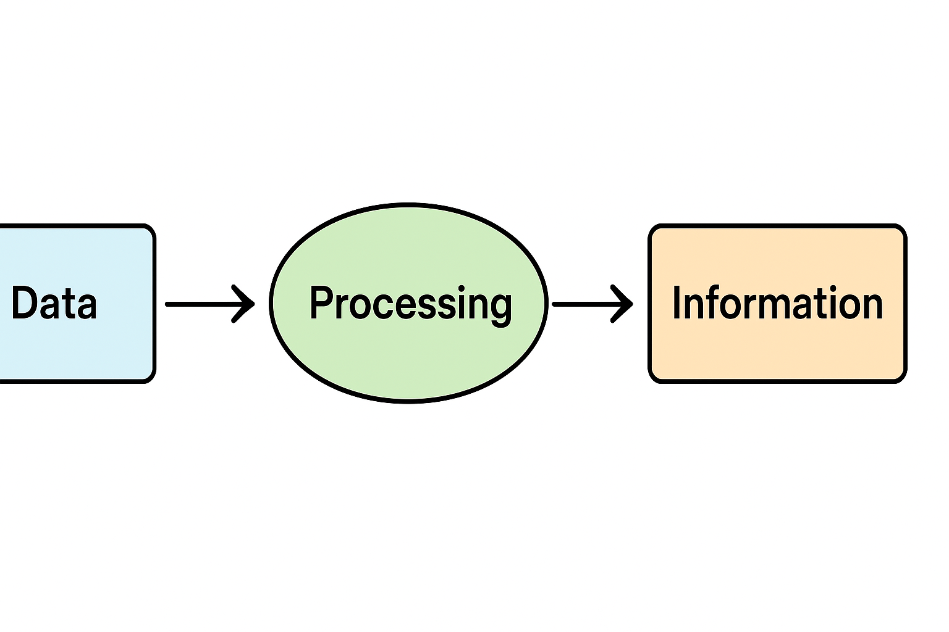
What is Data?
Definition (Simple)
Data = raw facts (numbers, text, symbols)
Examples
Student marks: 85
Employee ID: E102
Non-Example
Student performance (this is information, not raw data)
Notes:
New Courses replaced with New Programmes

Slide 11
What is a Data Structure?
Core Idea
A data structure is a way of organizing and storing data so that it can be used efficiently.
Industry Analogy
Books in a library rack (organized) vs books in a heap (disorganized)
Non-Example
Randomly storing values without structure
Notes:
New Courses replaced with New Programmes

Slide 12
Standard Definitions
Knuth: Organizing information for effective use
Cormen: Store data to facilitate access & modification
Key Terms: Efficient access + efficient update
Notes:
New Courses replaced with New Programmes

Slide 13
ACTIVITY SET 1: Daily Review –Explain, Don’t Guess
Write short answers (1–2 lines only):
What is the difference between a variable and an array?
Why do computers need memory?
What problem can occur if data is stored randomly?
Notes:
New Courses replaced with New Programmes

Slide 14
ACTIVITY SET 2: What is Data?– Concrete Thinking
Activity 2: Data or Not?
72
“Rahul”
“Rahul scored 72 marks”
“Rahul is a good student”
Task:
Which are data?
Which are information?
Why?
Notes:
New Courses replaced with New Programmes

Slide 15
ACTIVITY SET 3:
Activity 3: Definition in Your Own Words
Instruction:
Without memorizing, explain “Data Structure” in your own words using:
A real-life object OR
A daily activity
Notes:
New Courses replaced with New Programmes

Slide 16
Activity 4: Design Challenge
Question: Design a system to store:
Student names
Roll numbers
Marks
Constraints:
Fast search
Easy update
Minimum confusion
How will you store it?
What structure will you follow?
Notes:
New Courses replaced with New Programmes

Slide 17
Why Data Structure?
Foundation of Computer Science
Real world applications
Problem Solving
Transferrable skills
Data Structure
Algorithm Design and Analysis
Preparation for Interviews and Careers
Notes:
New Courses replaced with New Programmes

Slide 18
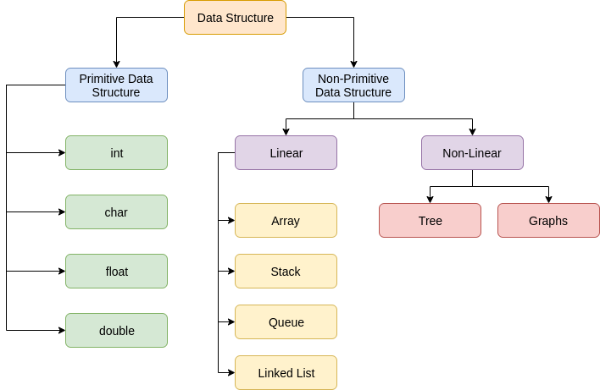
Classification of Data Structure
Notes:
New Courses replaced with New Programmes

Slide 19
Primitive Data Structures
Definition Basic data types directly supported by machine
Examples int, char, float, Boolean
Non-Example Tree, Graph
Notes:
New Courses replaced with New Programmes

Slide 20
Types of Primitive DS
Types of Primitive DS
Type | Size | Example
Boolean | 1 byte | true
Char | 2 bytes | 'A'
Int | 4 bytes | 25
Float | 4 bytes | 3.14
Double | 8 bytes | 99.99
Notes:
New Courses replaced with New Programmes

Slide 21
Operations on Primitive DS
Assignment
Arithmetic
Comparison
Logical
Worked Example
int a = 5 → a = a + 2
Notes:
New Courses replaced with New Programmes

Slide 22
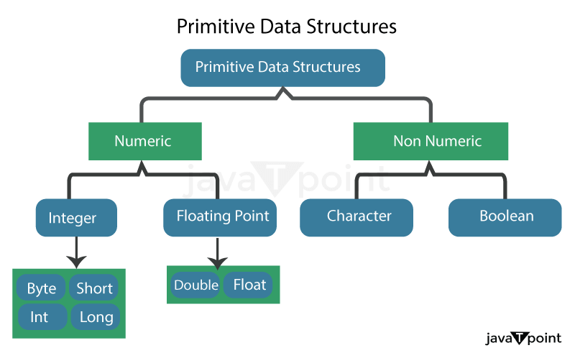
Primitive Data Structure
Fig. 9 : Classification of Primitive Data Structure
Notes:
New Courses replaced with New Programmes

Slide 23
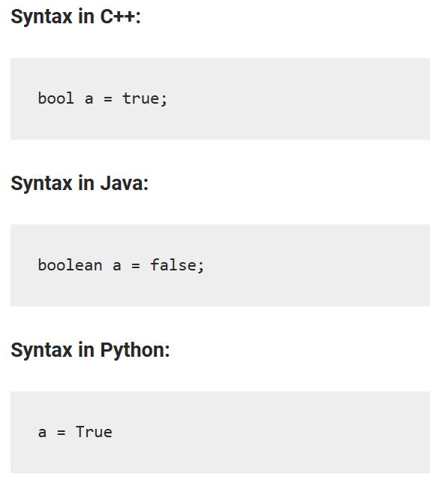
Types of Primitive Data Structures
Bool-
-Represents logical value, either ‘true’ or ’false’.
-Fixed size of 1 byte.
Notes:
New Courses replaced with New Programmes

Slide 24
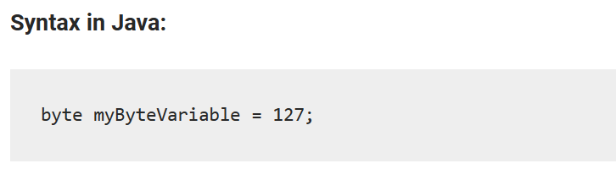

Types of Primitive Data Structures (Cont..)
2. Byte-
-Represents an 8-bit signed integer.
-use keyword ‘byte’ and size of 1 byte.
-Range of values from -128 to 127 (inclusive).
Syntax in C++:
Notes:
New Courses replaced with New Programmes

Slide 25
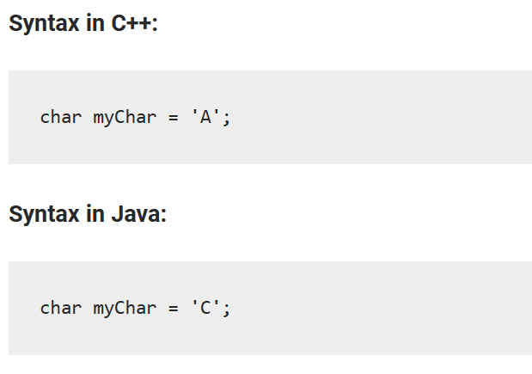
Types of Primitive Data Structures (Cont..)
3. Char-
-Represents single character.
-Example- a letter, a digit or symbol
-Fixed size of 2 bytes.
Notes:
New Courses replaced with New Programmes

Slide 26
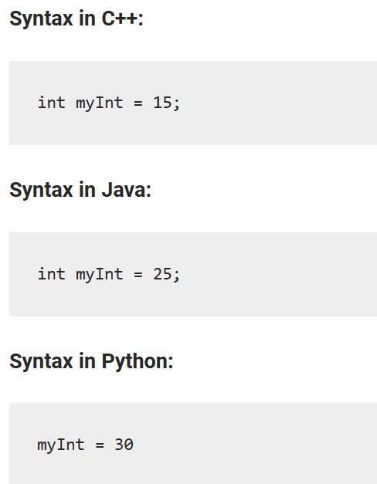
Types of Primitive Data Structures (Cont..)
4. Int-
-Represents integer values.
-Store both negative and positive whole numbers.
-Fixed size of 4 bytes in memory.
Notes:
New Courses replaced with New Programmes

Slide 27
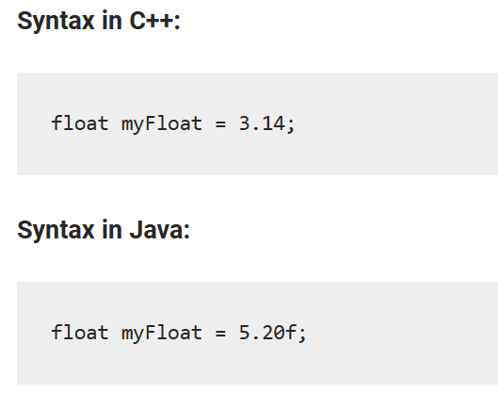
Types of Primitive Data Structures (Cont..)
5. Float-
-Represents floating-point numbers.
-Store real numbers (decimal values).
-Fixed size of 4 bytes in memory.
Notes:
New Courses replaced with New Programmes

Slide 28
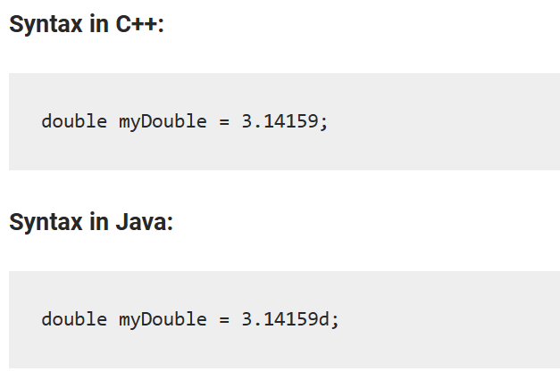
Types of Primitive Data Structures (Cont..)
6. Double-
-Store larger decimal values with large precision.
-Fixed size of 8 bytes in memory.
Notes:
New Courses replaced with New Programmes

Slide 29
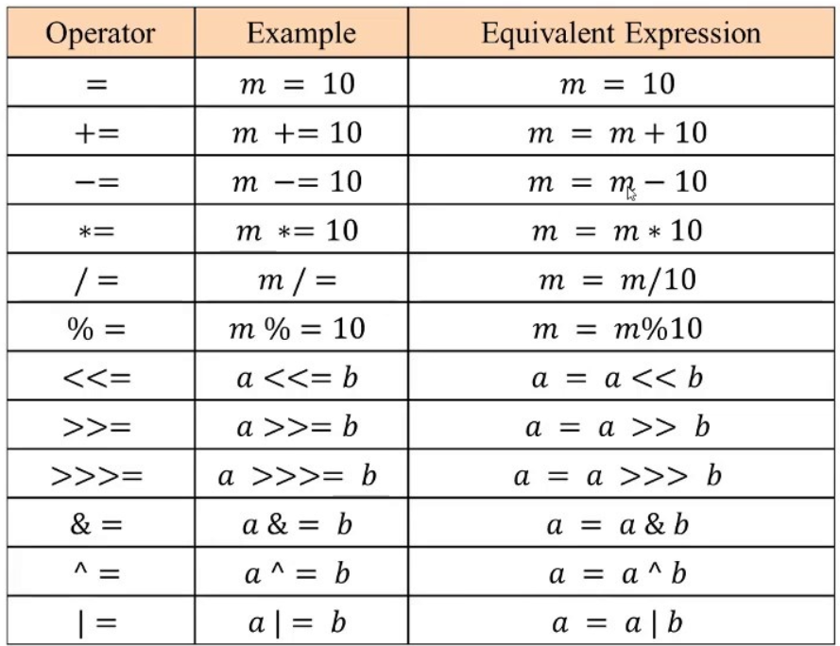
Operations on Primitive Data Structures
1. Assignment Operations-
-Act of putting a value in a variable.
Notes:
New Courses replaced with New Programmes

Slide 30
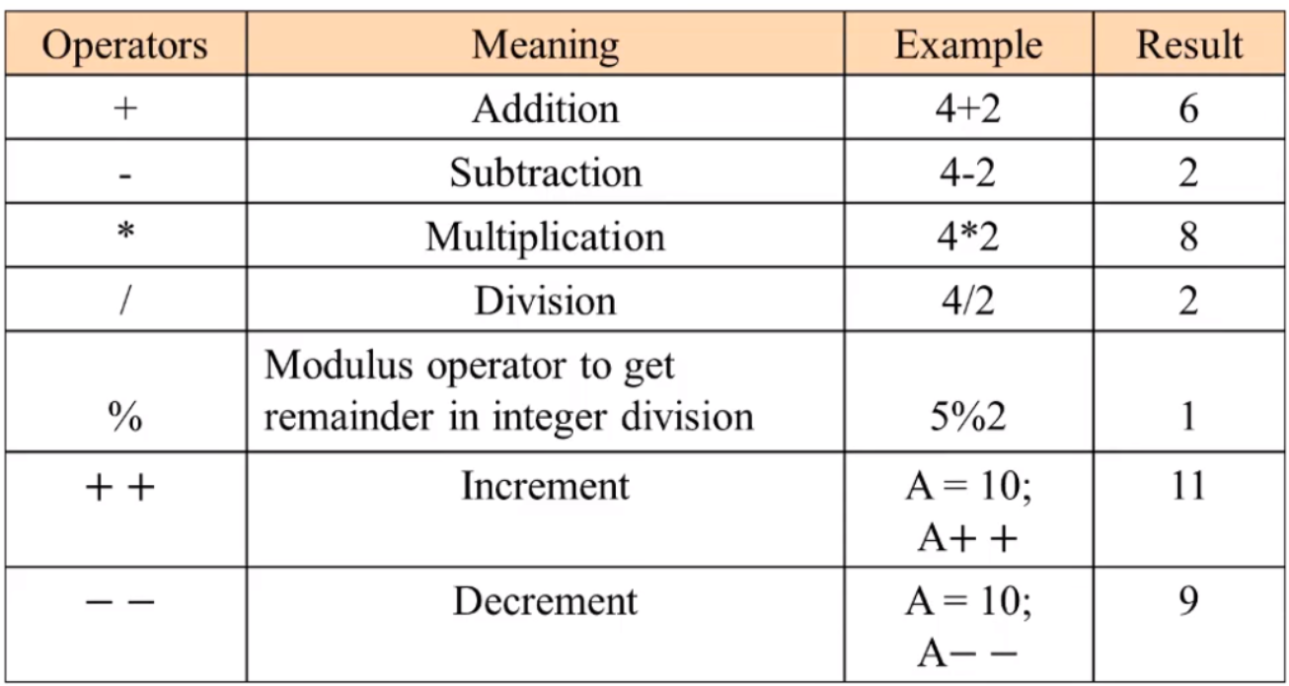
Operations on Primitive Data Structures
2. Arithmetic Operations-
-Mathematical calculations on numeric data type.
Notes:
New Courses replaced with New Programmes

Slide 31
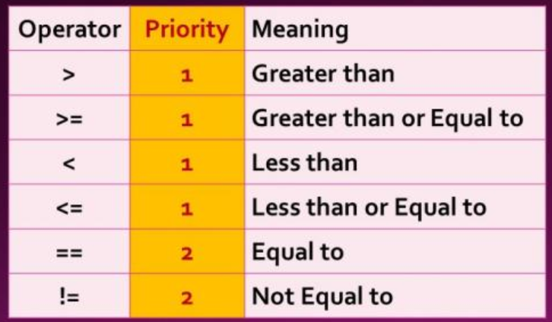
Operations on Primitive Data Structures (Cont..)
3. Comparison Operations-
-Compares two values and returns Boolean values.
Notes:
New Courses replaced with New Programmes

Slide 32
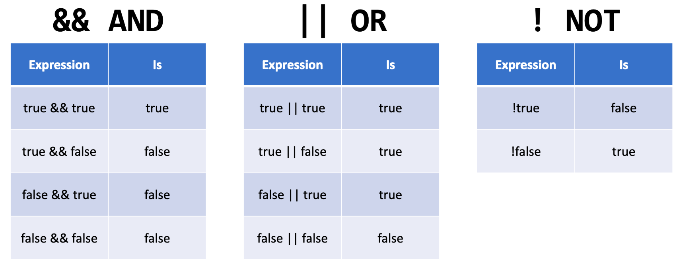
Operations on Primitive Data Structures (Cont..)
4. Logical Operations-
-Perform Boolean operations on Boolean data types.
Notes:
New Courses replaced with New Programmes

Slide 33
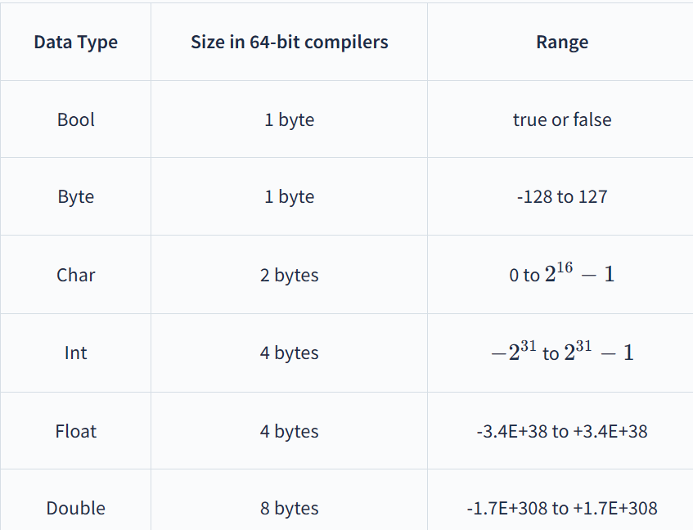
Key Features of Primitive Data Structure
1. Fixed Size- Example Integer takes up 4 bytes of memory.
Notes:
New Courses replaced with New Programmes

Slide 34
Key Features of Primitive Data Structure (Cont..)
High Speed- Perform calculations easy because of fixed size and format.
Memory Efficiency- Use minimal amount of memory.
Efficient Access and Manipulation- Since they are directly supported by the hardware, operations on primitive data structures are highly efficient.
Notes:
New Courses replaced with New Programmes

Slide 35
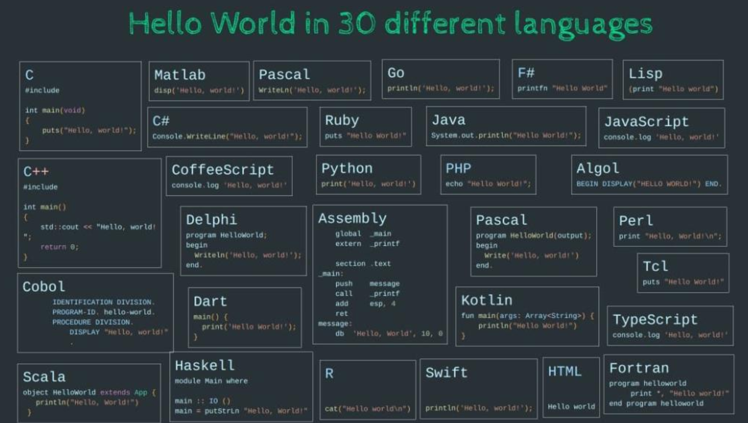
Key Features of Primitive Data Structure (Cont..)
5. Portability- Code can be easily adapted to another platform using different programming language.
Notes:
New Courses replaced with New Programmes

Slide 36
Features of Primitive DS
Fixed size
Fast processing
Memory efficient
Hardware supported
Portable
Notes:
New Courses replaced with New Programmes

Slide 37
Limitations of Primitive DS
Limited operations
Fixed size range
No abstraction
Limited precision
Analogy Single brick vs building
Notes:
New Courses replaced with New Programmes

Slide 38
NON-PRIMITIVE DATA STRUCTURES
Non-Primitive Data Structures
Definition Derived from primitive data types
Examples
Array,
Stack,
Queue,
Linked List,
Tree,
Graph
Notes:
New Courses replaced with New Programmes

Slide 39
Linear Data Structures
Definition Elements arranged sequentially
Examples
Array,
Stack,
Queue,
Linked List
Notes:
New Courses replaced with New Programmes

Slide 40
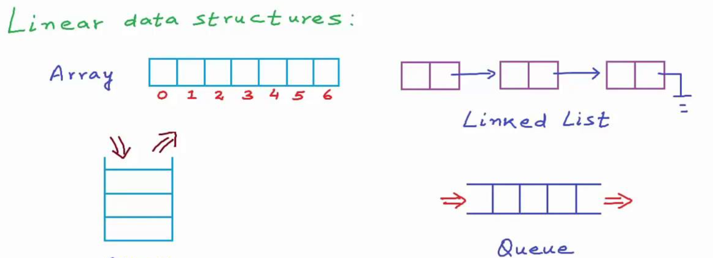
Primitive Data Structure (Cont..)
Fig. Examples of Non- Primitive (Linear) Data Structure
Notes:
New Courses replaced with New Programmes

Slide 41

ARRAY
Concept Homogenous & Contiguous memory locations.
Notes:
New Courses replaced with New Programmes

Slide 42
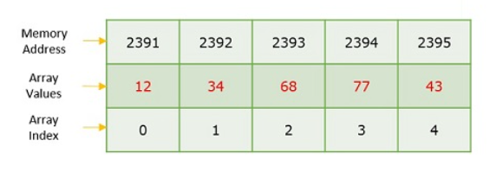
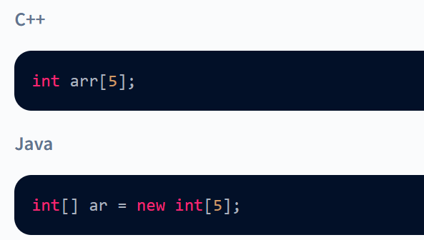
Array..
Exist in both single dimension and multiple dimensions.
Notes:
New Courses replaced with New Programmes

Slide 43
ARRAY..
Example Marks of students
Non-Example Linked list
Use Case: Contacts in a Phone
Question: What may be the other examples of the Array Data Structure
Notes:
New Courses replaced with New Programmes

Slide 44
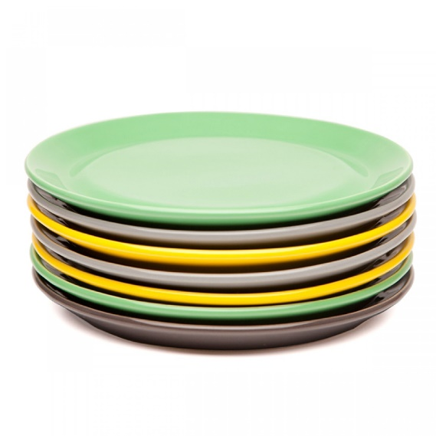
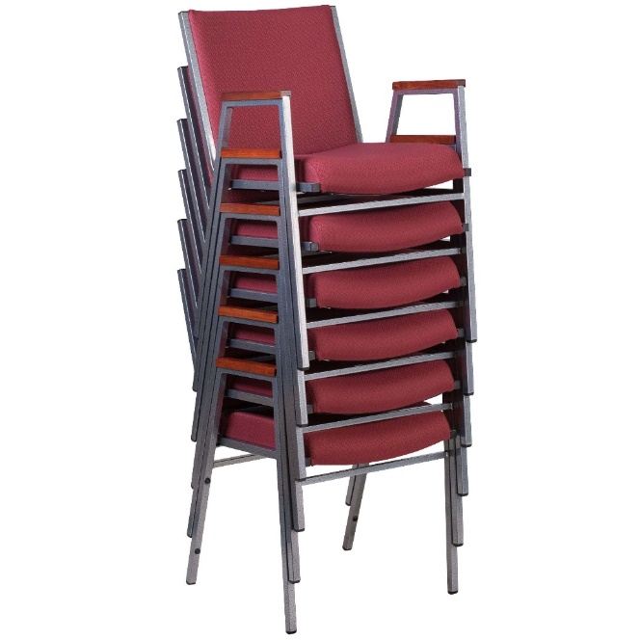
STACK
A stack is a linear data structure that follows the Last-In, First-Out (LIFO) principle, much like a physical stack of plates. Elements are added to and removed from only one end, called the "top" of the stack.
Notes:
New Courses replaced with New Programmes

Slide 45
STACK
Stack (LIFO)
Examples
Stack of plates
Undo operation
Operations: Push / Pop/Peek/ Top
Question: What me be the other examples of the Stack DS?
Notes:
New Courses replaced with New Programmes

Slide 46
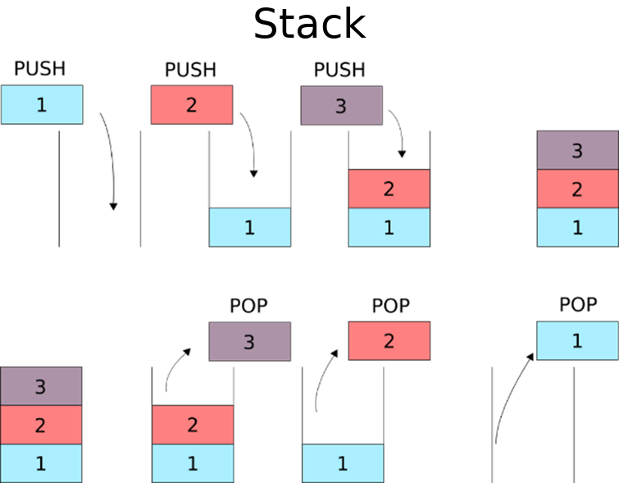
CONT..
Follows a particular order to perform operations.
LIFO(Last In First Out) or FILO(First In Last Out).
Notes:
New Courses replaced with New Programmes

Slide 47

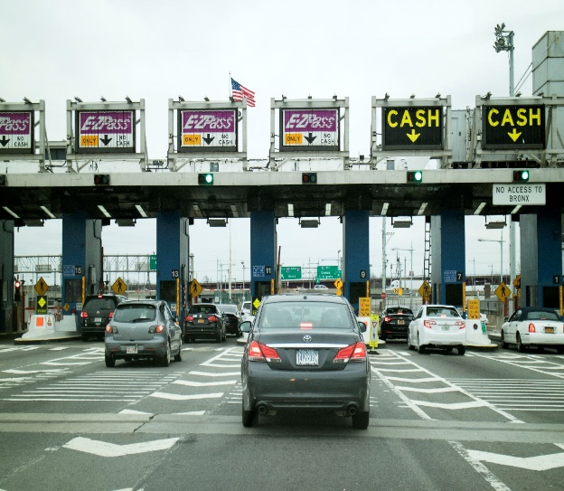
QUEUE
Queue (FIFO): Queue (Data Structure)- Online Ticket Booking, In Escalators, vehicles at toll center.
Notes:
New Courses replaced with New Programmes

Slide 48
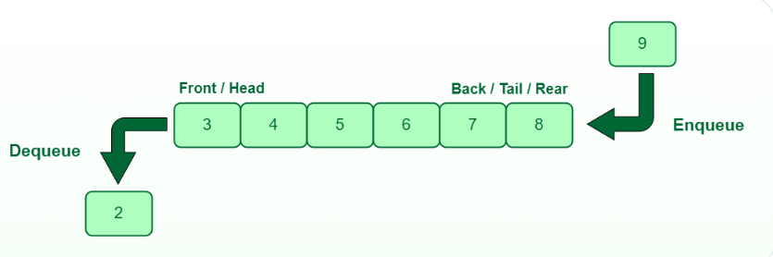
CONT...
Queue:
It is an ordered list.
Insertion operations from REAR end.
Deletion operations from FRONT end.
Fig : Examples of Linear Non- Primitive (Queue) Data Structure
Notes:
New Courses replaced with New Programmes

Slide 49
QUEUE..
Examples
Ticket booking
Toll booth
Operations: Enqueue / Dequeue
Question: What me be the other possible examples of Array DS?
Notes:
New Courses replaced with New Programmes

Slide 50
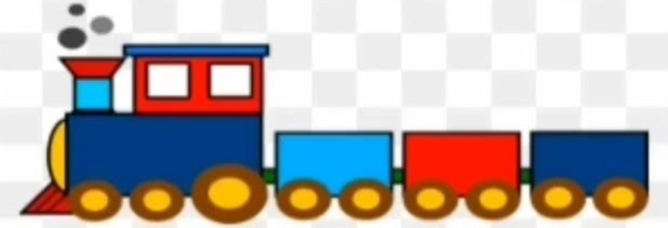
LINKED LIST
Concept Nodes connected via pointers
Use Case Browser navigation
Accessing pages using previous and next button
Notes:
New Courses replaced with New Programmes

Slide 51
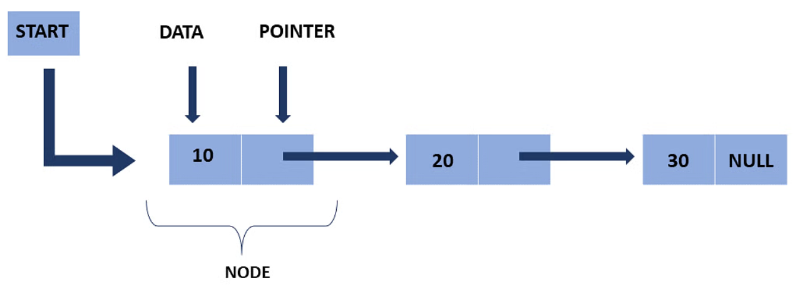
CONT..
A node consists of :
-- a data value and
-- a pointer to the address of the next node.
Fig: Representation of Linear Non- Primitive (Linked List) Data Structure
Notes:
New Courses replaced with New Programmes

Slide 52
Test Your Knowledge
UGC NET 2011
Question: Is string a linear data structure or not and why?
…………………………
Notes:
New Courses replaced with New Programmes

Slide 53
Limitations of Primitive Data Structures
Limited Functionality: Because they are atomic and indivisible, so limited operations.
Limited size range
Lack of abstraction: They don’t provide a way to abstract or encapsulate data, making it more difficult to manage and maintain large programs.
Limited precision: Sometimes produce unexpected results when used in calculations.
Notes:
New Courses replaced with New Programmes

Slide 54
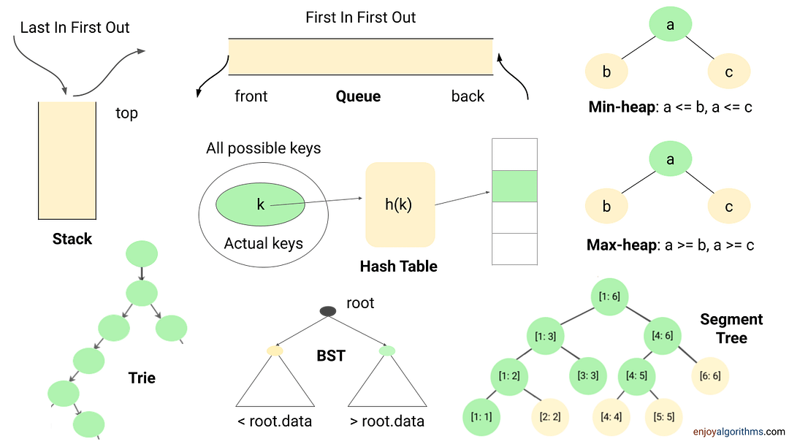
Non-Primitive Data Structure
Derived from primitive data structures
Fig : Examples of Non- Primitive Data Structure
Notes:
New Courses replaced with New Programmes

Slide 55
Limitations of Primitive Data Structures
Limited Functionality: Because they are atomic and indivisible, so limited operations.
Limited size range: For example, an integer data type in Java can store values between -2147483648 and 2147483647.
Lack of abstraction: They don’t provide a way to abstract or encapsulate data, making it more difficult to manage and maintain large programs.
Limited precision: Sometimes produce unexpected results when used in calculations.
Notes:
New Courses replaced with New Programmes

Slide 56
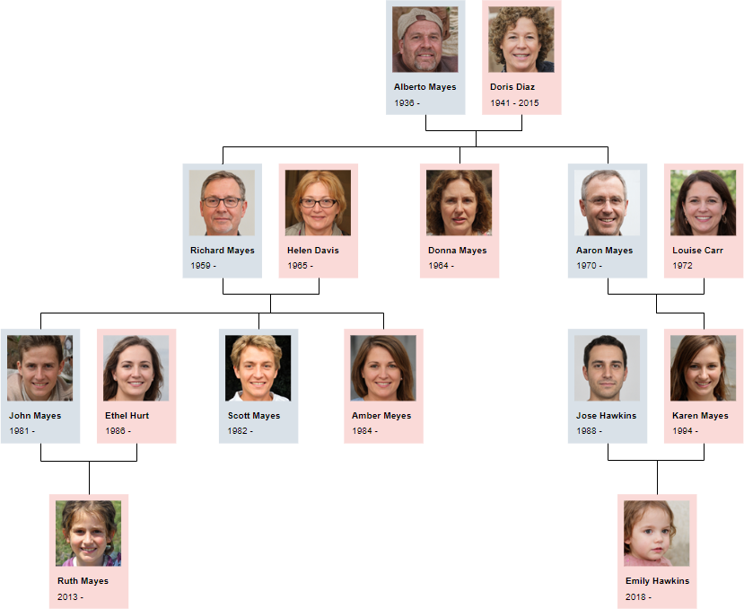
TREE
Tree: Connected Acyclic Graph
Examples
Family tree
File system
Notes:
New Courses replaced with New Programmes

Slide 57
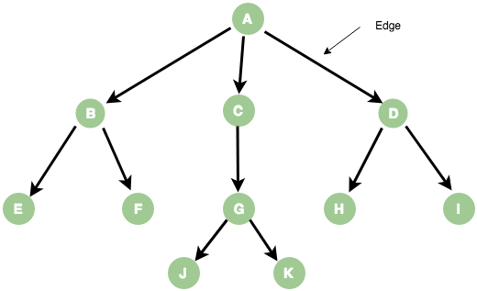
CONT..
Data item connected to other data item.
Hierarchical relationship or parent-child relationship.
Notes:
New Courses replaced with New Programmes

Slide 58

GRAPH
Graph: collection of vertices and edges
Examples
GPS navigation
Social networks
Notes:
New Courses replaced with New Programmes

Slide 59
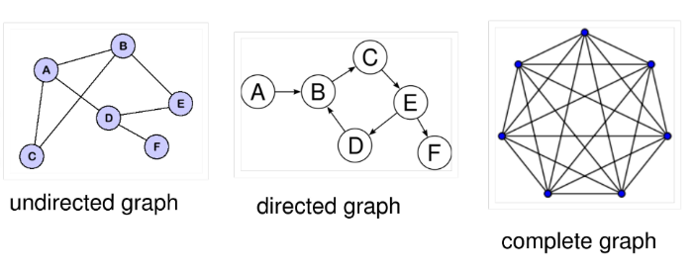
CONT…
Types of Graphs:
Fig : Types of Graph Data Structure
Notes:
New Courses replaced with New Programmes

Slide 60
Guided Practice (High Success)
Identify suitable data structure:
Browser back button
Railway reservation
Google Maps
Explain WHY
Notes:
New Courses replaced with New Programmes

Slide 61
Scaffold – How to Choose a DS
How to choose the DS?
Is order important?
Is fast search needed?
Are insertions frequent?
Notes:
New Courses replaced with New Programmes

Slide 62
Homework
Design a system to store:
Roll numbers
Names
Marks
Justify your data structure choice
Notes:
New Courses replaced with New Programmes

Slide 63
Reflection
What did we learn today?
One thing still unclear?
Notes:
New Courses replaced with New Programmes

Slide 64
Session Revision
Concept Map Data → Data Structures → Efficient Programs
Notes:
New Courses replaced with New Programmes

Slide 65
Session Revision
Data & Information
Why Data Structures Definitions (Knuth, Cormen, etc. → simplified)
Basic terminologies Classification
Primitive DS (types, operations, features, limitations)
Non-Primitive DS
(Linear & Non-Linear) Arrays, Stack, Queue, Linked List Trees & Graphs
Applications & use-cases
Notes:
New Courses replaced with New Programmes

Slide 66
Test Your Knowledge
Question Why is arranging students by roll number better than random seating during exams?
Notes:
New Courses replaced with New Programmes

Slide 67
THANK YOU

